Slide 1
How to prepare for timed tests

Slide 2
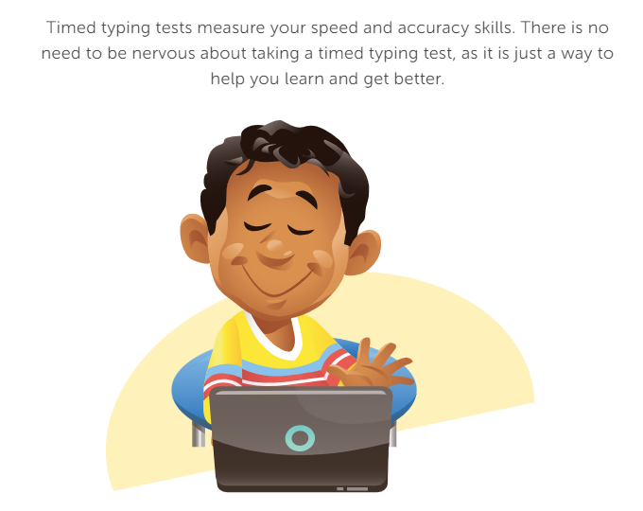

Slide 3
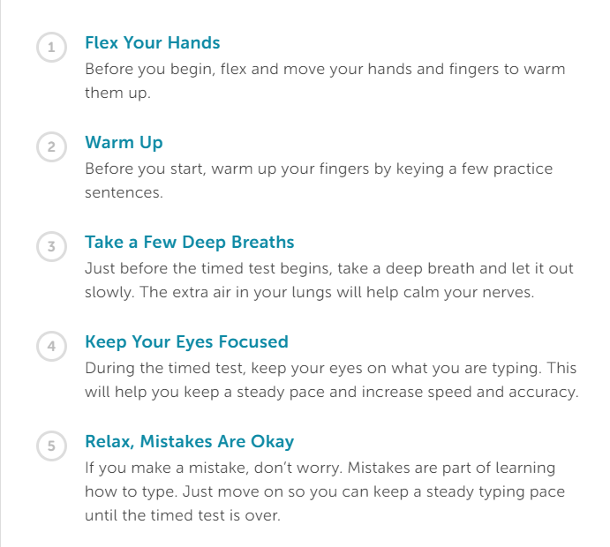

Slide 4
Complete How to Prepare for Timed Tests Review Packet

